Slide 1
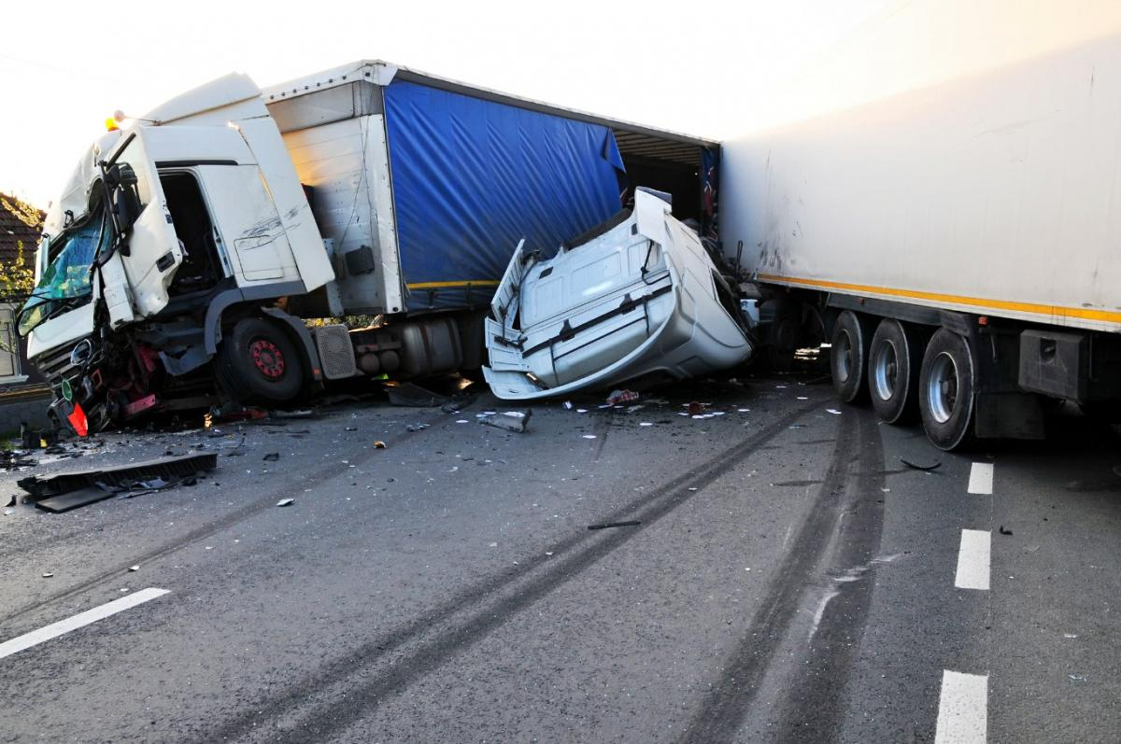
Best Truck Accident Lawyer In Northern California – York Law Firm

Slide 2
Causes of Truck Accident? 1. Driver fatigue: When commercial drivers become fatigued from excessive daily and weekly work hours, they substantially increase the risk of crashes. 2. Accidents caused by inexperienced drivers: Many trucking companies save money by using untrained, overworked, or inexperienced drivers. Employing these individuals can result in negligent driving. 3. Turning : Large trucks need more room than passenger vehicles to turn. 4. Runaway trailers: Sometimes, a trailer will disconnect from the truck, leaving all vehicles in its way in danger of a collision. 5. Defective parts: Sometimes, products have a defective design A tire that inexplicably blows out can indicate a defective design. 6. Unsecured loads: If load is improperly secured, it can fall off of an 18 wheeler, creating an obstacle course for other vehicles on the road.

Slide 3
Types Of Truck Accidents York Law Firm Handles: Every year, large truck collisions cause over 5,000 fatalities and almost 150,000 injuries. There are several different types of truck accidents York Law Firm handles, including: 1.Tractor Trailer Truck Accidents. 2. 18 Wheeler Accidents. 3. Rollover Accidents. 4. Jackknife Accidents. 5. Wide turn accident. 6. Blind spot accident.

Slide 4
Types Of Damages 1.Compensatory Damages: Compensatory damages are damages meant to “right the wrong.” In other words, they are meant to reimburse/make up for the injuries, harms and losses sustained by the victim. There are two types of compensatory damages: economic and non-economic damages. Economic damages include quantifiable amounts such as out-of-pocket expenses like medical bills, lost wages or property damage. Non-economic damages include pain and suffering, loss of companionship, physical injuries/harms, mental anguish and emotional distress. Non-economic damages will often exceed the amount of economic damages awarded, which is why you need to contact one of our skilled attorneys at York Law Firm. 2. Punitive Damages: Damages awarded to the victim in order to punish the wrongdoer for his or her gross negligence are known as punitive damages. Punitive damages are awarded where the conduct was malicious or in reckless disregard of the plaintiff’s rights, displaying an indifference to the rights and safety of others. Punitive damages may also be awarded when the defendant’s conduct is fraudulent or oppressive.

Slide 5
What A Truck Accident Lawyer Can Do For You? A truck accident lawyer can identify the liable party or parties, collect evidence, interview eyewitnesses, negotiate with the insurance company, and take the case to trial if necessary, on your behalf.

Slide 6
Contact Our Sacramento Truck Accident Lawyer
If you or a loved one has been involved in an accident with a big rig, please call us toll-free at 800-939-1832 or complete a questionnaire for a free truck accident consultation with York Law Firm.
Contact one of our Sacramento Truck Accident Lawyer today.
Email: info@yorklawcorp.com
Website: www.yorklawfirm.com
Contact us: 800-939-1832

